Slide 1

Falcons Purch Training 2024

Slide 2
Falcons Purch Facts (as of January 28, 2024)
14,993 requisitions approved so far in FY24
  22,272 requisitions approved in FY23 (most in a fiscal year by nearly 1,500 requisitions)
  On track to approve 26,063 requisitions in FY24 (most in a fiscal year by nearly 3,800 requisitions)
394 Independent Contractor Agreements signed in FY24
  On track to issue 685 ICA’s this fiscal year

Slide 3
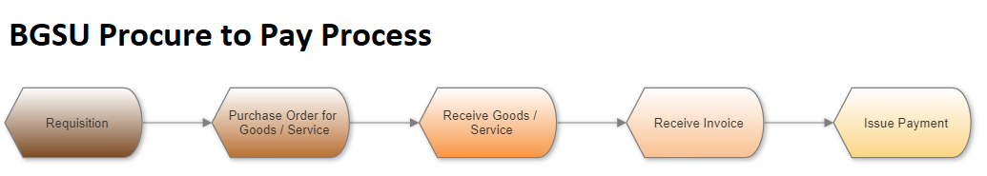
Procurement-to-Payment Process in Falcons Purch

Slide 4
Profile Management
Setting up/Changing Default Address
Adding Default Accounting Codes
  Full list of Accounting Codes are available on the Controller’s Website
Creating Email Approval Code
Notifications

Slide 5
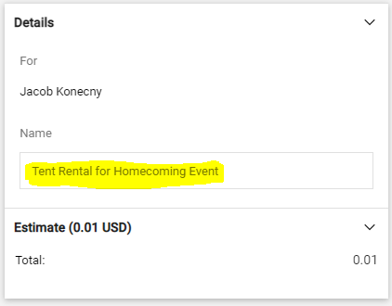
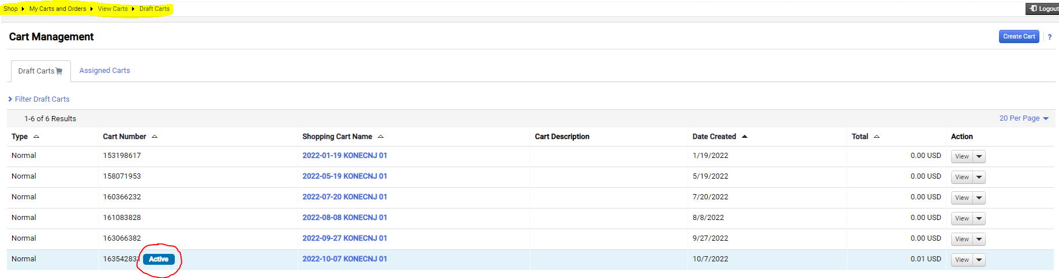
Cart Management
Finding Draft/Returned Carts
Creating a New Cart
Naming Shopping Carts
End Users can create carts and assign to requisitioners

Slide 6
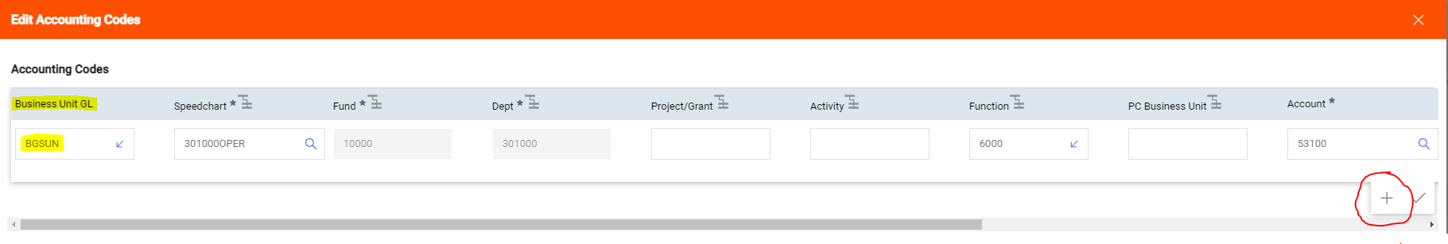
Accounting Codes
Speedchart Fields
Splitting a PO between different departments/funds/programs
Business Units (Accounting Codes AND Header)

Slide 7
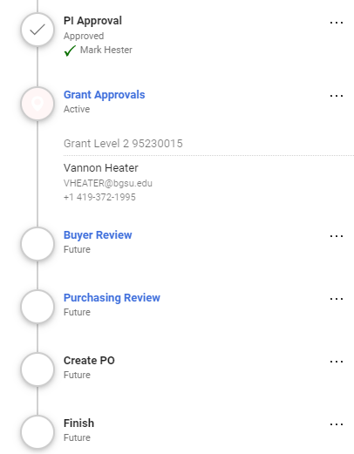
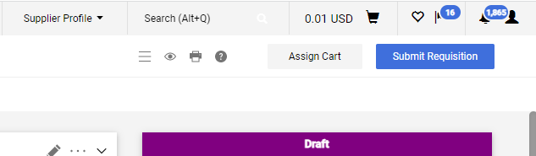
What’s Next?
Submit Requisition or Assign Cart
  Only Requestors have the ability to submit requisitions
Use the Workflow to determine where the requisition is in the approval process
Add comments within the requisition if needed

Slide 8
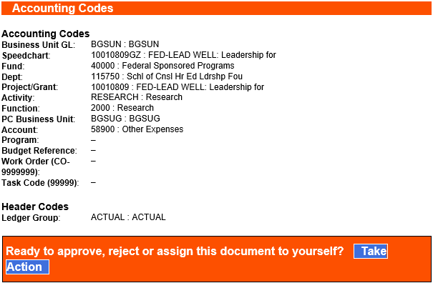
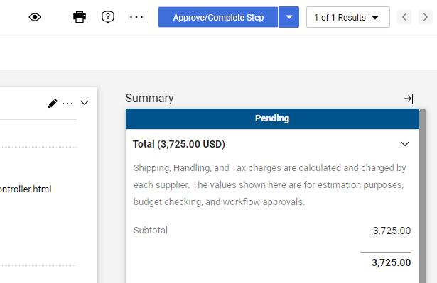
Approving Requisitions
Approving via Email
  Must have Approval Code set up prior
Approving in Falcons Purch

Slide 9
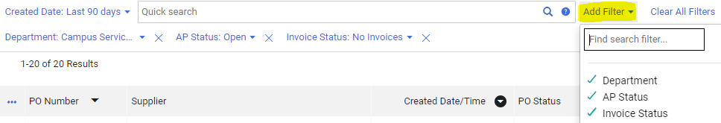

Document Search
Search Requisitions / Purchase Orders / Change Requests
Filters
Saved Searches
Search Exports to Excel

Slide 10
Sources of Requisitions
Non-Catalog Items
  Traditional Non-Catalog Item
  Blanket Purchase Orders
Punchouts
Bid Waiver Forms
Payment Requests

Slide 11
Non-Catalog Items
Definition:
  A shopping form that used when the supplier does not have either a hosted catalog or punchout Catalog
A Quote, Estimate, contract reference, or screenshot of Shopping Cart must be attached to requisition and should be submitted prior to receiving the good or service (exception: Blanket PO)
Proper UOM (Goods: EA, PK, BX, Services: EA, MNTH, QTR)
Non-Catalog Items should not be submitted to pay invoices (submit as Payment Request instead)
Purchase order will close when quantity is depleted (quantity can be increased with a Change Request)

Slide 12
Blanket PO’s
Definition:
  A non-catalog order that is estimated or will have multiple orders or payments throughout the year allowing the vendor to use one PO number for billing
Proper Unit of Measure (USD)
Proper Quantity (Always 1)
Check the “Blanket PO” Box in the Header
If applicable, add the contract number/dates of service to the description
Purchase order will close when dollar value is depleted (can be increased with Change Request)

Slide 13
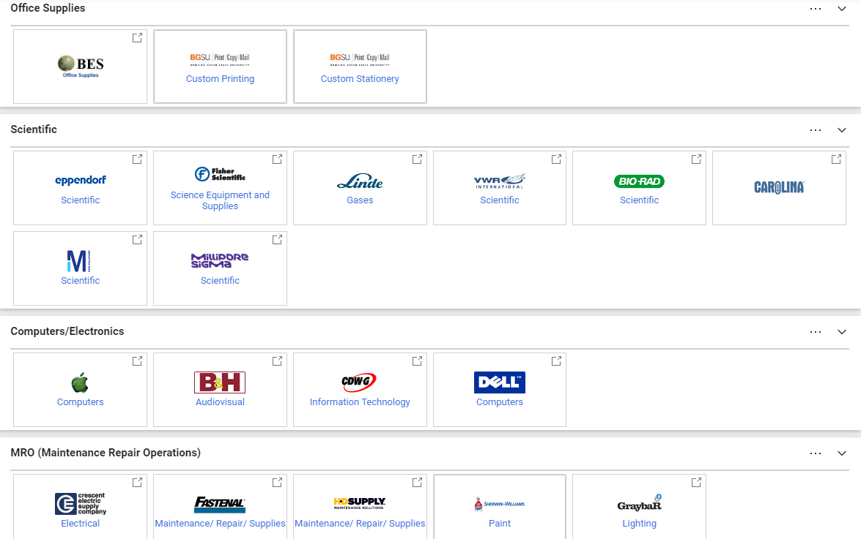
Punchouts
Definition:
  A catalog of contracted suppliers that have provided stores within Falcons Purch that allow users to shop from the supplier’s external website
Purchasing Review generally bypassed
Amazon: only make purchases through the Amazon punchout (not through external amazon.com Consumer website)

Slide 14
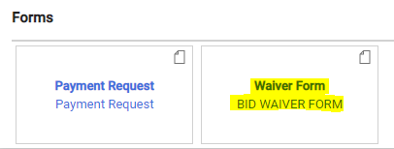
Bid Waiver Forms
Definition:
  When justified, the Purchasing Department has the authority to waive competitive bidding for departments seeking to purchase goods or services when either:
    The cost is of goods or supplies is $25,000 or greater
    The cost is of services provided is $50,000 or greater
Justifications for Bid Waiver: Sole Source, Emergency, or Economic
Proper Unit of Measure (USD) and Quantity (Always 1)
Check the “Blanket PO” Box in the Header
Bid Waiver Instructions

Slide 15
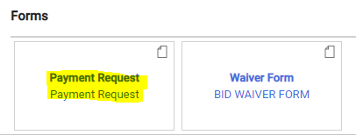
Payment Requests
Definition:
  A shopping form that is used when paying a vendor for services/goods that have already been provided (ALWAYS requires an invoice or contract)
Payment requests should only be used if one of the following criteria are met:
  The vendor being paid has a signed contract with the university (PO should not already be issued)
  The vendor is an independent contractor (ICA must be attached to the Payment Request)
  All other forms of payment should be done via non-catalog item
Automatically creates invoice for AP review – no receipt needed
  Do not enter until service is complete
Payment Request Instructions
Notes:
Payment requests should be the exception, not the norm.
Best practice is to issue a PO, so that the department has the funds already encumbered, as well as proof of pricing before goods/services are rendered.

Slide 16
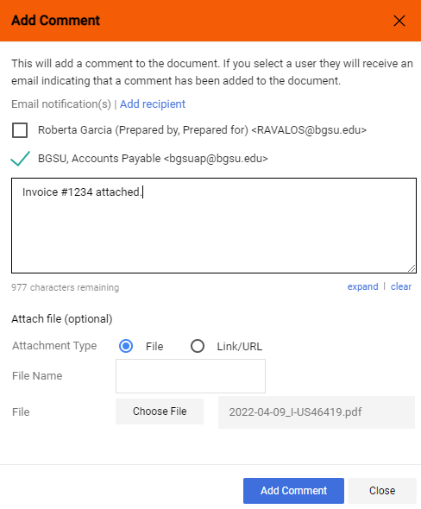
Invoices
Only applicable to non-catalog items, blanket POs, and bid waivers
Invoices received by Department
Add comment on original PO to bgsuap@bgsu.edu
Attach invoice to comment
Monitoring invoice status
  “In Process” = still in AP approval process
  “Payable” = AP approval process completed

Slide 17
Receipts
Definition:
  Receipts are required for all purchase orders (PO) that are greater than $999. Receipts should not be entered until after the goods/services have been received.
Types of Receipts:
  Quantity Receipts: used when the Unit of Measure is EA
    Triggered by traditional PO’s
    Enter the number of items you have received for each line
  Cost Receipts: used when the Unit of Measure is USD
    Triggered by blanket PO’s/bid waivers
    Enter the dollar amount of the items that have been received
Receiving Instructions

Slide 18
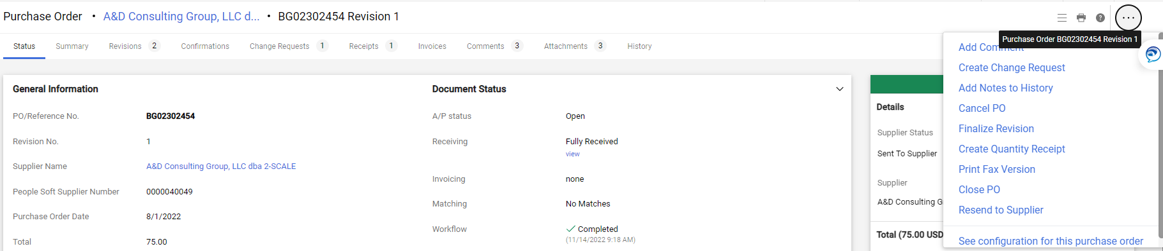
Change Requests
Definition:
  A Change Request is a request to modify an existing non-catalog purchase order.
Change Request workflow will be the same as the requisition workflow
PO must still be in Open Status
Increase or decrease amount of PO by clicking into line-item description once Change Request has been created
Descriptions should be detailed on the changes being made to the PO
Change Request Instructions

Slide 19
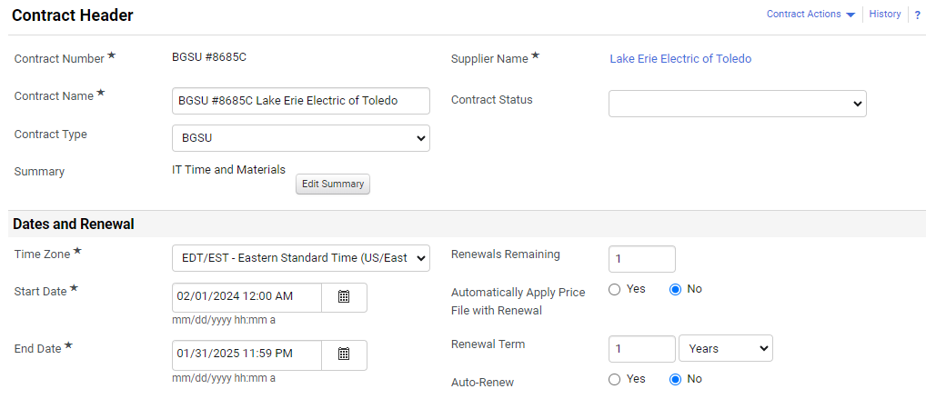
Contract Module
NEW feature in Falcons Purch that allows users to access key information about their department’s contracts
Houses all contracts on file with Purchasing
End-users can receive notifications for their department's contracts

Slide 20
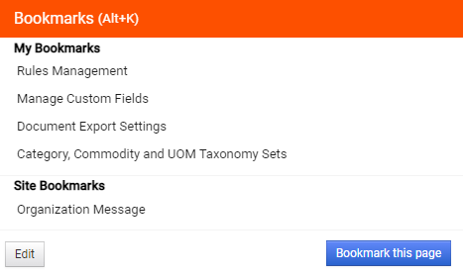
How to be Efficient in Falcons Purch
Favorites
Export Results
Work in separate windows
Dashboards

Slide 21
Falcons Purch
Questions and Answers

Slide 22
Resources
Falcons Purch Instruction Guides
Falcons Purch New User Training Video
FMS Security Request Form
Purchasing Best Practices Guide
BGSU Purchasing Website
Falcons Purch Inquiries:
Name | Phone | Email
Purchasing Main Line | 419-372-8411 | purchasing@bgsu.edu

Slide 23
Thank You!

