Slide 1
Awards Training
2023
Purchasing | Procure to Pay | Controller’s Office

Slide 2
Agenda
Introductions
Definition of Awards / Why it Matters
PaymentWorks Entry
Falcons Purch / Chrome River
Foreign Individuals Process and Specifics
Decision Tree and Reference Guide
Resources and Q&A

Slide 3
Overview of Awards
Definition:
Prizes and awards are payments:
In recognition of charitable, scientific, educational, artistic, literary, or civic achievement, or;
Are received as the result of entering a contest or competition, or;
Are received based on their performance as employees
Drawing gifts or monetary payments are also classified as prizes
Why it Matters:
If certain dollar thresholds are satisfied, the University is required by federal law to report the prize or award to the IRS and the recipient on either:
IRS Form 1099-MISC, Miscellaneous Income, or;
IRS Form 1042-S, Foreign Person’s U.S. Source Income Subject to Withholding, or;
IRS Form W-2 Wage and Tax Statement
Awards can impact a student’s financial aid package
Note: in higher education, the term “award” is also used with regard to Student Financial Aid

Slide 4
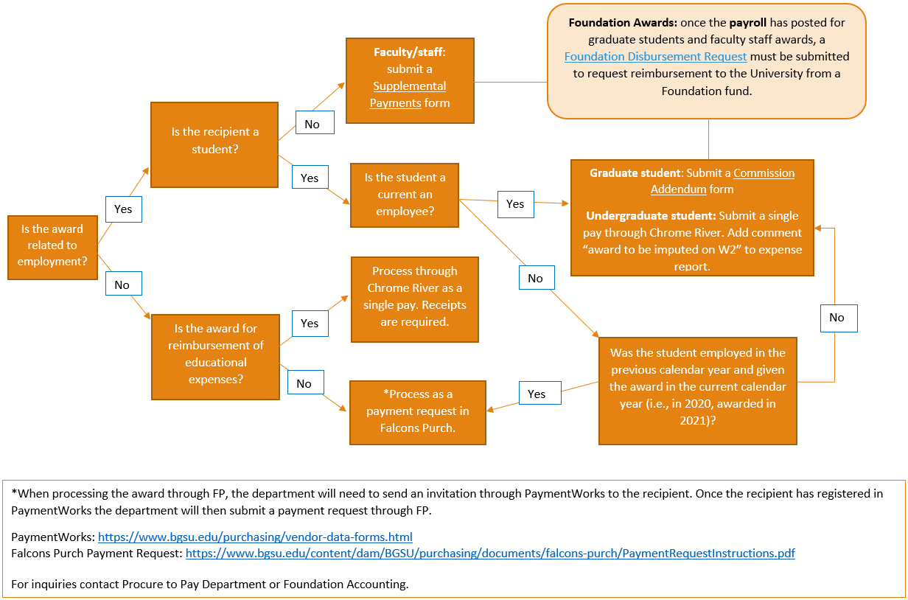
Onboarding / PaymentWorks Entry
PaymentWorks is the main source of Award submission for consideration
Required Documentation to attach to invite:
Award Criteria
Procure to Pay Manager reviews invitation before it is released to the recipient
United States citizens: Awards may be taxable through a 1099 process in FMS/Falcons Purch
Foreign individuals: Awards may be taxable based on the individual’s home country through process in Glacier

Slide 5
Award Payment Tools
Payment of awards can be issued through either Falcons Purch, Chrome River or a wire transfer
Which method should I use to issue payment?
1099 tax implications guide the decision of what system to use
Flat fee vs. Dollar-for-Dollar receipts
Type of award / award criteria

Slide 6
Entering Awards into Falcons Purch
Awards should ONLY be paid via a Payment Request if done through Falcons Purch
Required Documentation to attach to requisition:
Award Criteria
Award Notification
Things of Note:
Supplier Invoice Number: should be either date of award OR date entered into system
Commodity Code: 20000000 (FP Services)
Account Code should ALWAYS be 58292 (Awards)
If the award is being paid out of a Foundation account, be sure to change the Business Unit to BGFDN in the Accounting Codes AND Header

Slide 7
Entering Awards into Chrome River
Awards should be paid via a Single Pay if done through Chrome River
Required Documentation to attach to report:
Award Criteria
Award Notification
Things of Note:
Check “Non-Employee Expense Report” when starting report!
Expense Type should be Misc (found through Equip/Library/Misc → Misc)
Account Code should ALWAYS be 58292 (Awards)

Slide 8

General Awards
Questions and Answers

Slide 9
Foreign Individuals Process
Foreign individuals providing services to BGSU from foreign location
No tax withholding obligations to tax country – can be paid via wire transfer
Foreign individuals providing services to BGSU in the United States OR Foreign individuals receiving an award unrelated to a job
Payroll enters individual’s information into Glacier (Glacier will confirm if taxes must be withheld)
If taxes do not need to be withheld:
Department should initiate Payment Request in Falcons Purch if individual has a U.S. address or bank
Department should initiate a wire transfer if the individual does not have a U.S. address or bank
If taxes must be withheld:
PaymentWorks registration must be canceled
Department should initiate Single Pay in Chrome River if the individual has a U.S. address or bank
Department should initiate a wire transfer if the individual does not have a U.S. address or bank

Slide 10
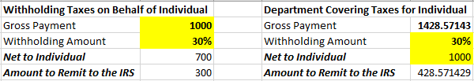
Foreign Individuals Specifics
NRA – Tax withholding
How it affects your budget
Use the Glacier Withholding Calculator to help determine tax withholdings
Wire transfers
Used for individuals that do not have a U.S. address or bank
Possible wire transfer fee (could be up to $50)

Slide 11
Awards Decision Tree

Slide 12
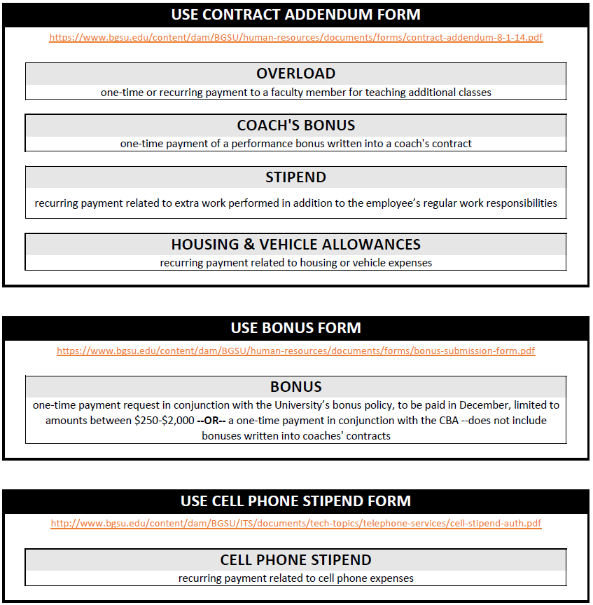
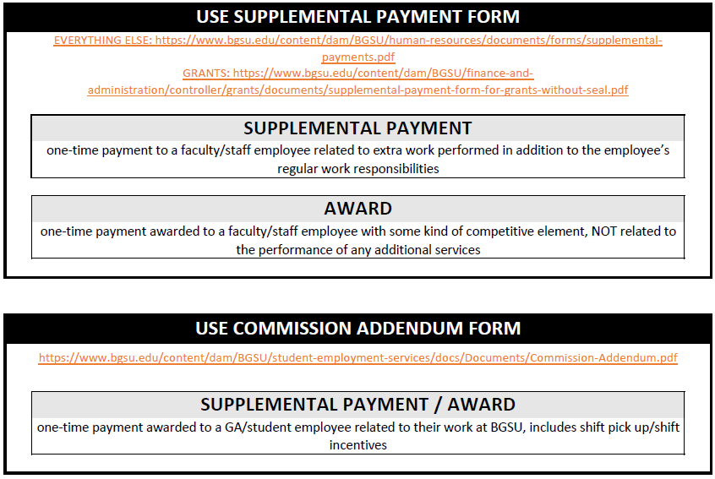
Awards Reference Guide

Slide 13
Resources
PaymentWorks Award Instructions
Falcons Purch Payment Request Instructions
Chrome River Single Pay Manual
BGSU Purchasing Website
BGSU Controller’s Office Website
Awards Inquiries:
Name | Phone | Email
Kristina Rhine, Procure to Pay Manager | 419-372-4694 | krhine@bgsu.edu
Bob Swanson, Controller | 419-372-8597 | rswanso@bgsu.edu

Slide 14
Awards
Questions and Answers

