Slide 1
Model Comparisons for Predicting New Subscribers and Market Segmentation
Endale Altaye & Casey Whorton
Department of Applied Statistics and Operations Research
Bowling Green State University

Slide 2

Presentation Outline
Background information
Objectives
Modeling
  Implementation
Market segmentation
  Sample
Conclusion and recommendations

Slide 3


Background Information
Over 37,000 client records
4,000 client records
19 characteristics and subscription status
Demographics
Relationship to bank
Previous marketing information

Slide 4


Problem Statement
Which clients have the best chance of saying “yes” to a long term deposit?

Slide 5

Objectives
All clients
Group 1
Group 2
Group n
Create model
Market segmentation

Slide 6
What We Want
Records for clients we want to contact about subscribing to a bank’s term deposit
?
Chances of each client subscribing
Name | Job | Loan | …… | Subscribe
John S. | admin | No | … | ?
Mary J. | CEO | Yes | … | ?
… | … | … | … | ?
Name | Job | Loan | …… | Subscribe
John S. | admin | No | … | 90%
Mary J. | CEO | Yes | … | 25%
… | … | … | … | 60%

Slide 7

Finding The Best Prediction Model
Try 5 models and compare
Client records
Notes:
Sensitivity = predicted_yes/true_yes. I.e. Sensitivity is more important for predicting ‘yes’ outcomes than the other scores. After sensitivity, mis-class places observations into correct groups.

Slide 8


Training Data and Test Data
Original client records
Create models
60%
of data
Evaluate & compare models
40%
of data

Slide 9
Model Selection
 | Misclassification Rate | Specificity | Sensitivity | Precision
Logistic | 0.0890 (3) | 0.9749 (1) | 0.4093 (5) | 0.6747 (1)
Linear Discriminant Analysis | 0.0891 (4) | 0.9384 (5) | 0.6285 (1) | 0.4982 (5)
Quadratic Discriminant Analysis | 0.1363 (5) | 0.9419 (3) | 0.4224 (4) | 0.5632 (3)
Decision Tree | 0.0886 (2) | 0.9398 (4) | 0.6278 (2) | 0.5108 (4)
Random Forest | 0.0858 (1) | 0.9633 (2) | 0.5246 (3) | 0.6429 (2)
Winning model: Random Forest

Slide 10
Implementation
4,000 client records
Random Forest Model
Chose 400 with best chances of subscribing
Name | Job | Loan | …… | Subscribe
John S. | admin | No | … | ?
Mary J. | CEO | Yes | … | ?
… | … | … | … | ?
Name | Job | Loan | …… | Subscribe
John S. | admin | No | … | 52%
Mary J. | CEO | Yes | … | 10%
… | … | … | … | ?

Slide 11

Objectives
All clients
Group 1
Group 2
Group n
Create model
Market segmentation

Slide 12

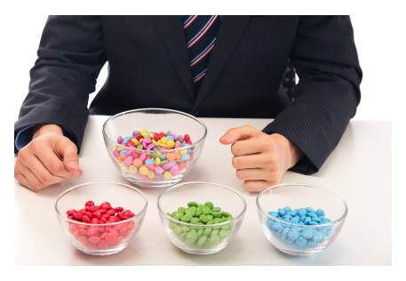
How Do We Separate Clients Into Groups?
Group 1
K-means Clustering
Method
Group 2
All clients
Algorithm for sorting clients into groups
Group n

Slide 13




Market Segmentation
Groups
Proportion within group
Subscribers
Group
20 groups total
7 groups have good subscription rates

Slide 14



Group A
Students
Mostly single
High school or university education
Group B
Retired
Mostly married
Variety of ed. levels
Most have no home loan
30.5 % of clients said “yes”
25.5 % of clients said “yes”
Overall: 11% of clients said “yes”
Notes:
Note: that the overall percentage was 11% saying yes.

Slide 15
Objectives
All clients
Group 1
Group 2
Group n
Create model
Market segmentation

Slide 16
Conclusion and Recommendations
List of clients in the group that have the best chance of subscribing
Group A
Students
Mostly single
High school or university education
Random Forest Model
Prioritize groups with high proportion of subscribers
Tailor marketing to groups
Utilize the Random Forest Model for large groups
Save resources

Slide 17
Thank you

