Slide 1
Emburse Enterprise
Reimbursements
Training for 2025-2026

Slide 2

Outline
Reimbursement Overview
Business Purposes
Expense Types and Documentation
International Travel
Summary

Slide 3
Bowling Green State University shall conduct its business-related travel activities in an efficient and cost-effective manner that supports the mission of the university while maintaining compliance with applicable state and federal laws and regulations.
- University Travel Policy

Slide 4
Reimbursement Overview
Requirements from the IRS, the State of Ohio, BGSU, and your department
Department requirements will be communicated to you by your supervisor or budget administrator ​
University requirements can be found on the BGSU general counsel website: https://www.bgsu.edu/general-counsel/university-policies.html​
University Travel Policy
International Travel by Faculty and Staff
University Food Service Policy
The IRS or State could audit BGSU at any time
BGSU is also audited yearly by an external organization
No expenses can be reimbursed in advance of event
“Expense reimbursements must be submitted within 90 days of travel. Reimbursements submitted after 90 days, if approved, will be made as a taxable reimbursement.”

Slide 5
Business Purposes

Slide 6
Business Purpose
Expenses must be ordinary and necessary
“An ordinary expense is one that is common and accepted in your industry. A necessary expense is one that is helpful and appropriate for your trade or business.”
- IRS Publication 535

Slide 7
Business Purpose (cont.)
All expenses must have a clear business purpose
Business Purpose: The business-related reason for the expense
Justifies why BGSU, not the employee, should pay for the expense
Specifically states what the expense was for
e.g., “Airfare to attend ABC Client Meeting in Chicago on Aug. 3” rather than “Travel”
Clear enough that any viewer can understand
Reviewers, auditors, the public
Supported by appropriate documentation for the expense type

Slide 8
Expense Types and Documentation

Slide 9
Common Expense Types
What documentation is needed?
Per Diem
Mileage
Supplies
Business Meals/Student Group Meals
Registration Fees/Memberships & Dues
Hotel
Airfare
Rental Car
Fuel
Taxi & Rideshare
Tolls
Parking
Public Transportation
Software
Each expense type requires different documentation. Overall, documentation must show the relevant information for the business purpose.

Slide 10
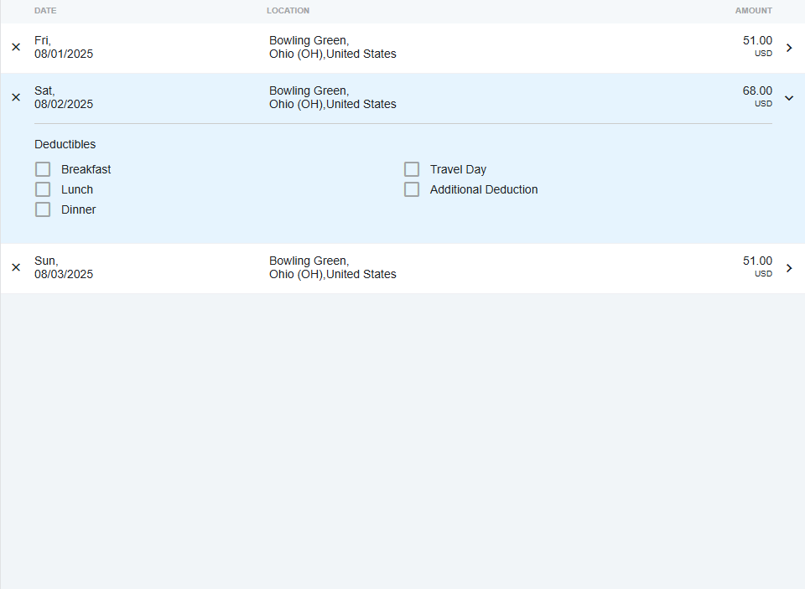

Per Diem
Daily Personal Meals Reimbursement
What is Per Diem?
“The university will reimburse meals at the IRS standard per diem rate…IRS per diem rates are provided as a total daily rate.”
Per diem covers all personal meals (provided they are not covered by the event/conference), an itinerary is utilized as opposed to receipts
Per diem can be claimed for all days listed in the event’s itinerary as well as one day before and after the dates listed
Days spent traveling to and from destination must be marked as “Travel Day” by checking the corresponding box
All meals provided at the event or conference must be checked with the corresponding boxes
e.g. A day spent at the conference, not traveling, where breakfast and lunch is provided, would have the “Breakfast” and “Lunch” boxes checked, all others would be unchecked

Slide 11
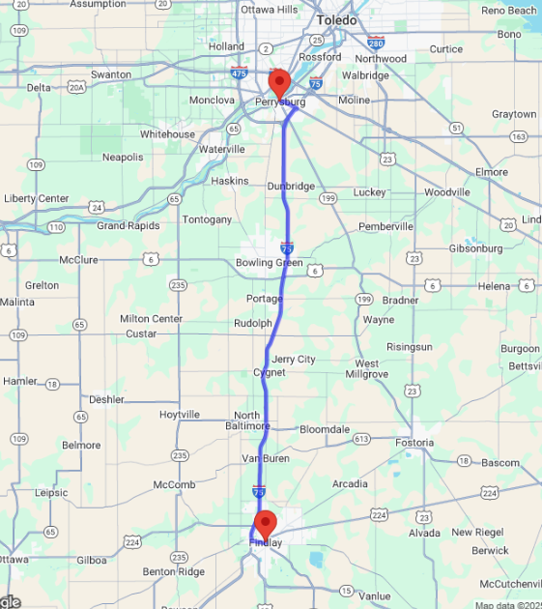
Mileage
Reimbursement for Personal Car Usage
Reimbursable
What documentation is required?
Starting and ending locations
Must be addresses or specific locations
Starting location is typically BGSU or home address, whichever is closer to destination
BGSU will only reimburse mileage in excess of expected daily commute, unless traveling between business locations
e. g. Traveler lives in Findlay and is traveling to Perrysburg for an approved event, they would only submit reimbursement for the distance from BGSU to Perrysburg, as the distance from Findlay to BGSU is the “expected daily commute” for an employee
Not Reimbursable

Slide 12
Mileage (cont.)
Fly vs. Drive
“Mileage reimbursements for a traveler who chooses to drive rather than fly should not exceed the lowest round trip coach airfare available at the time travel was authorized. The traveler must supply documentation to support what the airfare would have been at that time.”
If the cost of flying is less than the cost of the standard mileage reimbursement for the same distance, then BGSU will only reimburse the cost of the flight
e.g. Driving from BGSU to Philadelphia. Mileage reimbursement is $376.60 (538 miles * $0.7 per mile) If a round-trip flight for a similar time is $275, BGSU will only reimburse $275 if you still elect to drive
A fly vs. drive comparison must be provided as an attachment for all mileage reimbursements over 7 hours
IN SUMMARY: BGSU will reimburse the lesser of mileage reimbursement or the cost to fly

Slide 13
Supplies
Ordinary and Necessary Business Supplies
What documentation is needed?
Must have a receipt that shows that the full amount that is being reimbursed was paid
No tax on purchases in the state of Ohio
Tax on online purchases or purchases outside of Ohio are okay
If there is a name on the receipt, it must match the name of the person being reimbursed
This applies for all expense types
If the expense was paid for in gift cards or reward money, we need documentation that shows that the person being reimbursed paid for the gift card/reward money themselves
e.g. If you paid for paid for paper with a Staples gift card, we need documentation that you bought the gift card yourself. If you did not pay for the gift card, it is not considered an out-of-pocket expense

Slide 14
Business Meals/Student Group Meals
Meals for Groups of People (Not Individual Meals)
What documentation is needed?
Business Meals vs. Student Group Meals
Business Meals: Meals where business is discussed
Student Group Meals: Meals for a group of students where no business is discussed
Needs an itemized receipt and a list of everyone that attended the meal
If there were no external guests, put a note in the error that states “No external guests”
Alcohol must use a BGFDN account
No more than two drinks per person
Tips will only be reimbursed up to 20%
This applies for all expense types, including taxi/rideshare expenses

Slide 15
Registration Fees/Memberships & Dues
Registering for a Conference/Event or Dues to an Organization
“University funds may be used for individual memberships for professional organizations only when having such a membership:
(1) Is a necessary condition of an individual being able to perform a university job as reflected in the employee’s job description; or
(2) Advances a university program or purpose such as, for example, the membership is necessary for a faculty member to carry out university research responsibilities; or
(3) Membership is included in a conference registration fee allowing for a reduced rate to attend the conference and the savings over the non-member registration fee rate is greater than the cost of individual membership in the organization.”
What documentation is needed?
Must have a receipt that shows that the full amount being reimbursed was paid
Pay attention to department rules for registration fees and memberships
Reimbursements for registration fees cannot be paid before an event takes place
This applies to all expense types, including airfare and hotels
To avoid this issue, pay on a Pcard

Slide 16
Hotel
Lodging for an Event
What documentation is needed?
Receipt must show that the full amount being reimbursed was paid
Some travel websites will provide a quote or say, “amount due at property,” and these are not receipts
No reimbursements will be paid for room service or food charged to the room as food is paid by per diem
Tax is reimbursable for hotels even in the state of Ohio
“When in the State of Ohio, the traveler should inquire as to the availability of a state tax exemption due to the tax exempt status of the university. A copy of the university’s tax exemption certificate may be obtained from the Office of the Controller webpage.”
The dates of the hotel stay must line up with the dates on the provided itinerary and travel days
Airbnbs and similar lodging arrangements must have prior approval

Slide 17
Airfare
Transportation to an event further away
What documentation is needed?
Receipt must provide information such as flight class and show that the flight was paid for
Flight confirmations must show that the amount is paid
Must be an economy or main cabin flight
“University employees are expected to take advantage of the lowest airfare available and to obtain the lowest possible fare by booking travel tickets well in advance of planned travel times, whenever possible.”
“No reimbursement will be made for first-class or premium rates where other options are available. Expenses claimed under this section must be supported by a ticket stub, receipt, confirmation, or similar evidence of expense showing the details (destination and cost) of travel.”
Boarding passes are the preferred way of showing that the flight was paid and taken, but are not necessary
Remember the rule for fly vs. drive

Slide 18
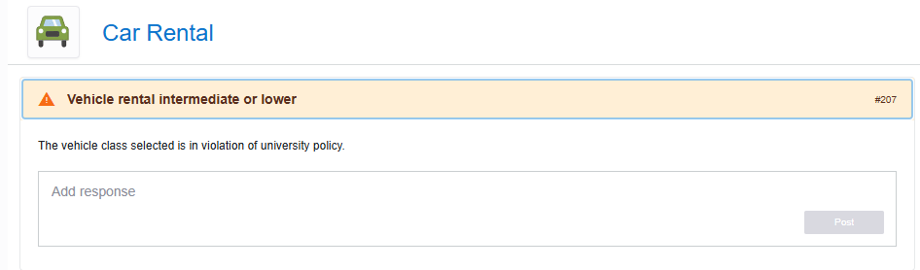
Rental Car
Transportation if traveler elects to fly as opposed to taking a personal vehicle
“Rental cars are authorized if their use is as economical as any other type of transportation. Additionally:
Reimbursable expenses. Travelers may be reimbursed for a rented vehicle and for the gasoline purchased for official university business in the rental vehicle.
Vehicle Class. University guidelines do not provide for the reimbursement of luxury vehicles. The university standard is an intermediate size car or comparable vehicle.
Insurance. The employee should waive the rental company’s loss/damage supplemental liability and/or personal accident insurance when utilizing the University vendor (Enterprise). Insurance should be accepted when renting outside from other companies.”
Documentation
Receipt for payment of vehicle must be provided
If the traveler must rent a car above the “economy/compact” class because of availability or group travel, allow error in line item and provide explanation in the available space. You will still be permitted to submit

Slide 19
Fuel
For rental cars (not personal cars) only
What documentation is needed?
“Travelers may be reimbursed for a rented vehicle and for the gasoline purchased for official university business in the rental vehicle”
Must have a receipt if it is over $25
“Generally, no personal travel expenditures will be reimbursed without a receipt. The IRS permits the following exceptions: de minimis expenditures (individual small dollar purchases less than twenty-five dollars for items such as bridge tolls, short term parking, and cab fare) and meal per diem.”

Slide 20
Taxi & Rideshare
Transportation using a taxi or rideshare app
What documentation is needed?
“If the traveler is required to use other transportation (bus, taxi, subway, ferry, etc.) between airports, between home and the departure point, at a destination or overnight lodging, the actual cost of the transportation will be reimbursed. Receipts must be obtained and provided for any fare that exceeds twenty-five dollars.”
It is very easy to tip over 20% using Lyft or Uber. Remember that tips up to 20% will be reimbursed
Rideshare apps sometimes provide documentation that says, “This is not a payment receipt.” Make sure that what you are attaching is a receipt that shows payment information
No taxis to or from personal meals
These are considered incidental expenses and are covered by per diem

Slide 21
Tolls, Parking or Public Transportation
Miscellaneous transportation expenses
What documentation is needed?
Receipts required except for de minimis expenditures
Parking at airports must line up with the dates on the provided itinerary and travel days

Slide 22
Software
Purchases of computer software
What documentation is needed?
Needs ITS approval except if it is a subscription-based software
e.g. ChatGPT is subscription based and does not need ITS approval
Receipt is necessary for reimbursement
Remember the 90 day rule

Slide 23
International Travel

Slide 24
This term refers to travel whenever a destination is outside the fifty States of the United States of America or the District of Columbia. Travel to U.S. territories (including American Samoa, Guam, Northern Mariana Islands, Puerto Rico, the U.S. Virgin Islands, and the United States Minor Outlying Islands) and journeys on the high seas are also considered international travel.
- International Travel by Faculty and Staff Policy

Slide 25
International Travel
See previous slide for definition
What are the rules for international travel?
“Faculty and staff must register their URT [University Related Travel] in the international travel registry. In addition to obtaining any needed supervisory approval, registration of URT is required for reimbursement. If the URT is not properly registered, then under the University Travel policy, the University will deny expense reimbursement.”
It must be registered before departure. Please attach the confirmation email that you receive when you register to the expense report
See the International Travel by Faculty and Staff policy for more specifics on international travel before you leave
Must have reasonable path, start, and end dates
Everything is allocated on a day-to-day basis
Business days = travel days + days your presence was required + certain holidays and weekends
This includes days prevented from working due to reasons out of your control
For more specifics on international travel, please contact Bob Swanson and refer to the policies

Slide 26
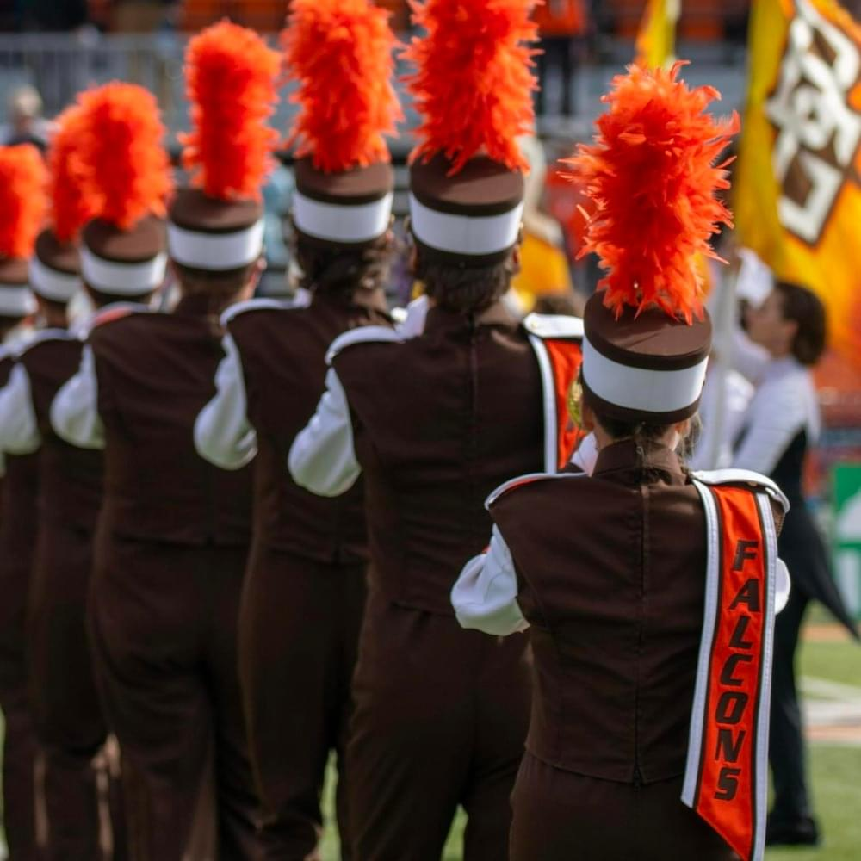
Summary
Provide a business purpose for all expenses
Receipts are required for all expense types other than per diem and mileage
Special exceptions apply
International travel requires an international travel registration

Slide 27
Any
Questions?
For more information, please contact bgsuap@bgsu.edu

