Slide 1


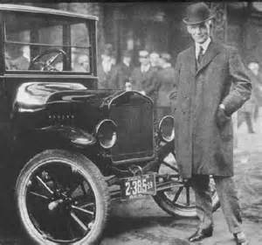
Do you want to be an Entrepreneur?
Can you identify these people?

Slide 2
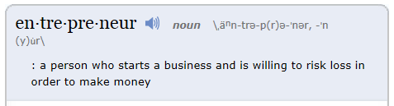
What is an Entrepreneur?
Today’s entrepreneurs are problem solvers and idea generators who help create jobs that stimulate the economy.
What skills and education do entrepreneurs need to be successful?

Slide 3
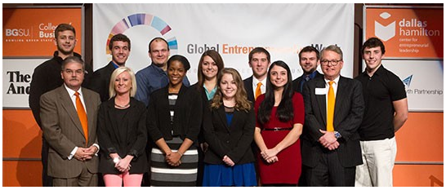
Today entrepreneurs go to college to learn how to start, grow and succeed in running their own ventures.

Slide 4
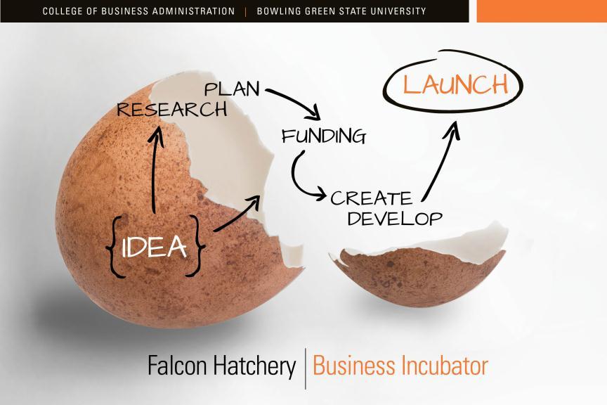
The Entrepreneurial Discovery Process
Vocabulary words:
Idea
Feasibility
Cost
Marketing
Sales
Distribution
Investor

Slide 5
The Hatch
In the Fall of 2013 the “Hatch” was created. Eighty students submitted applications describing their unique business ideas in hopes of launching their own new business venture.
The “Hatch” is modeled after the Shark-Tank television show.
It gives the student entrepreneurs a chance to pitch their business ideas to “Falcon” investors who might invest real money in their company.

Slide 6
The Hatch
Things to observe as you watch the “Hatch”
Investor reaction
Technique of the student presentations
Audience involvement
Intensity of all the participants
What lasting impressions did each student have on you?

