Slide 1
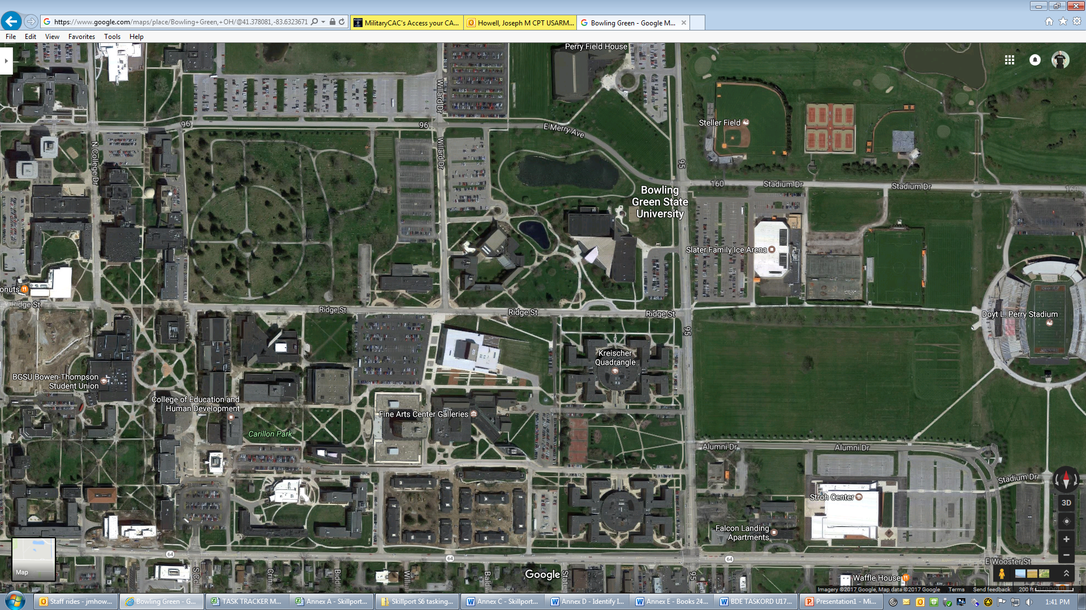
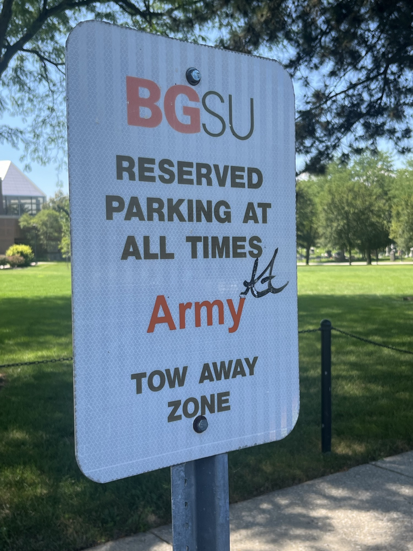
GPS Address is 1022 Ridge St.
Bowling Green, OH
POC: Mr. Joe Howell
Cell# 781-588-5514
parking
Park in Army Parking spot closest to building.
LOT N
Memorial Hall, Rm 151
Two Rows of Paid Parking
I-75/Hotel is this direction

